Slide 1
Company Overview
Gina Diaz
Enterprise Account Executive, SLED (State, Local Government, K12)
Notes:
Introduce yourself

Slide 2
Who We Are
We deliver solutions that bring speed, precision and efficiency
to every phase of the building lifecycle. Some of our significant
industry contributions include:
Developer of Facilities Intelligence Solutions for strategic decision making
Pioneer of RSMeans data, industry-standard cost estimating data
Creator of
Job Order Contracting (JOC)
process and data
Notes:
Gordian is the pioneer of facility and construction cost data, software and expertise for every phase of the building lifecycle.
Our innovative solutions enable our customers to build and maintain the essential facilities and infrastructure our communities rely on.
We deliver solutions that bring speed, precision and efficiency to every phase of the building lifecycle.
Some of our significant industry contributions include:
Facilities Intelligence Solutions for strategic decision making
Pioneer of industry-standard cost estimating data, RSMeans data
Gordian’s founder, Harry H. Mellon was the creator of the Job Order Contracting (JOC) process and data

Slide 3
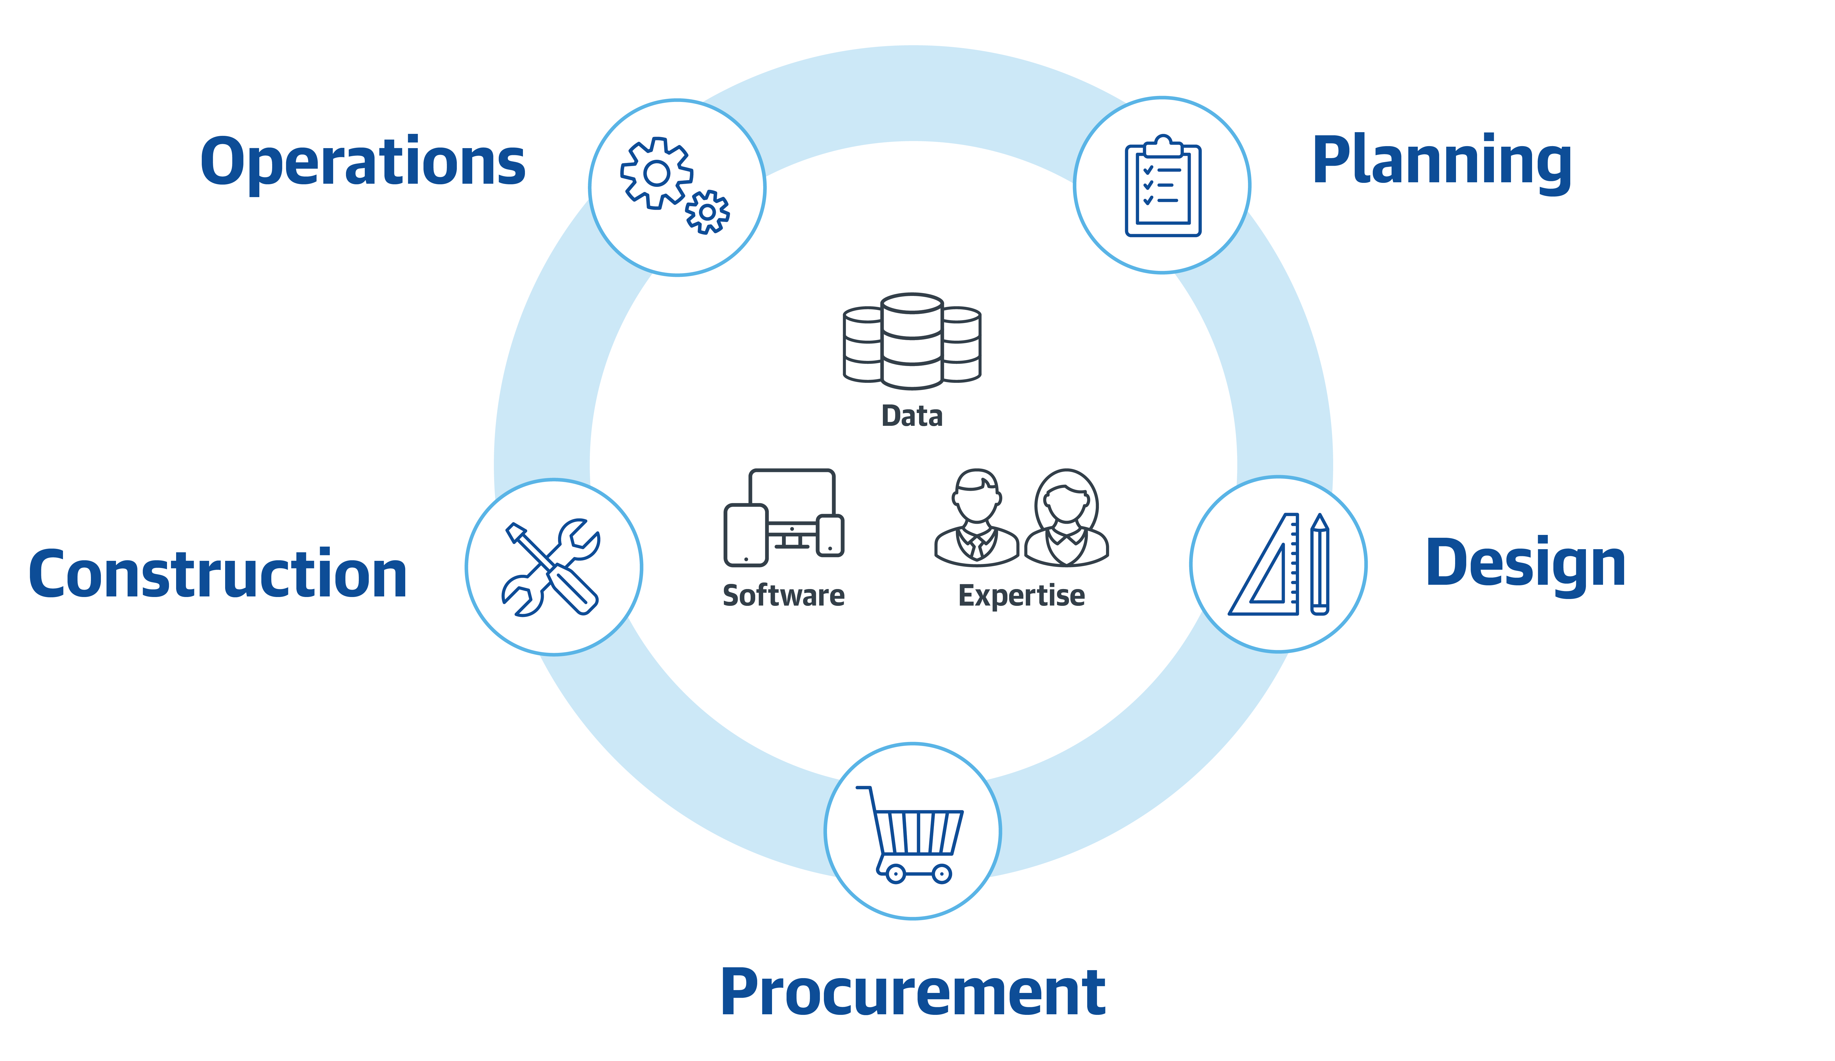
Data
Drive Meaningful Action
Software
Improve Workflows
Expertise
Deliver Results
Notes:
Gordian helps agencies better manage the full building lifecycle of your facilities and infrastructure. This includes understanding the condition of your building portfolio, developing maintenance strategies and making the case for continued investment, defining accurate project budget estimates and gaining efficiencies when procuring and executing construction work. Gordian helps ensure our customers are maximizing resources every step of the way.
What sets us apart is that we provide a comprehensive solution to your challenges. We combine the right data, software and expertise necessary to drive meaningful action, improve workflows and deliver results. While other companies may provide one aspect – perhaps just the data analysis or a standalone software solution – Gordian brings all three together and works as an extension of our customers’ teams to truly make an impact.

Slide 4





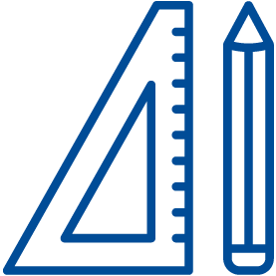
Who We Serve
State and Local Government
K12
Higher
Education
Healthcare
Federal Government
Architects,
Engineers and Contractors
Notes:
Our expertise goes all the way back to why we were founded. Gordian is uniquely positioned to help improve processes and make a difference in state and local government agencies, Education, Healthcare, the Federal Government and with those A/E/C firms that partner with those agencies.

Slide 5
Gordian’s Commitment to Our Customers
Gordian acquired VFA and Kykloud solutions to expand our facility planning portfolio – May 2021
This expansion to Gordian’s existing planning portfolio offers a unique combination of technical expertise, streamlined data collection and strategic capital planning and analysis capabilities.
Our highly strategic solutions fulfill our commitment of providing robust solutions that address customer needs throughout the entire building lifecycle.
Notes:
Gordian’s commitment to the planning and pre-construction phases
You may have heard within , an exciting update for Gordian is the acquisition of VFA and Kykloud. Gordian acquired VFA and Kykloud solutions to expand our facility planning portfolio – May 2021
This expansion to Gordian’s existing planning portfolio offers a unique combination of technical expertise, streamlined data collection and strategic capital planning and analysis capabilities.
Our highly strategic solutions fulfill our commitment of providing robust solutions that address customer needs throughout the entire building lifecycle.

Slide 6
For more information, visit gordian.com

